Slide 1
A Look At CIS Security Benchmarks (1)
Center for Internet Security (CIS)
https://www.cisecurity.org/cis-benchmarks/
Fill out your details and will receive an email with link

Slide 2
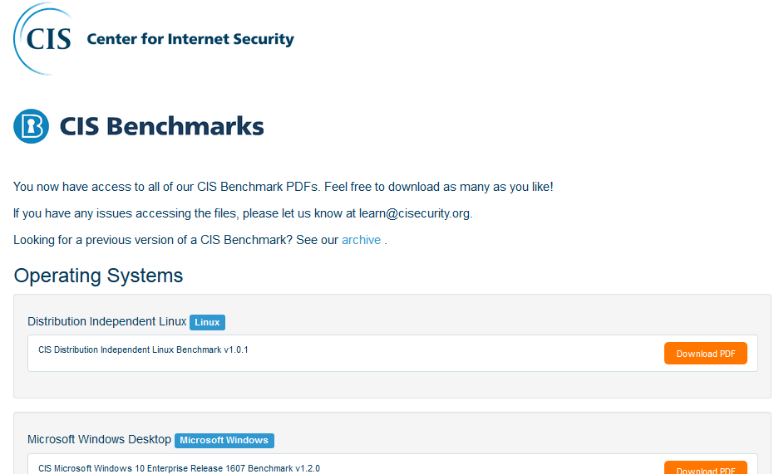
A Look At CIS Security Benchmarks (1)

Slide 3
A Look At CIS Security Benchmarks (2)
# | OVERALL CIS BENCHMARK CATEGORIES | TOTAL
1 | OPERATING SYSTEMS | 36
2 | SERVER SOFTWARE | 33
3 | CLOUD PROVIDERS | 2
4 | MOBILE DEVICES | 8
5 | NETWORK DEVICES | 6
6 | DESKTOP SOFTWARE | 21
7 | MULTIFUNCTION PRINT DEVICES | 1
 | GRAND TOTAL CIS BENCHMARKS | 107

Slide 4
A Look At CIS Security Benchmarks (1)
# | OPERATING SYSTEMS | TOTAL
1 | DISTRIBUTION INDEPENDENT LINUX | 1
2 | MICROSOFT WINDOWS DESKTOP | 5
3 | DEBIAN LINUX | 2
4 | UBUNTU LINUX | 3
5 | AMAZON LINUX | 1
6 | CENTOS LINUX | 2
7 | ORACLE LINUX | 2

Slide 5
A Look At CIS Security Benchmarks (1)
# | OPERATING SYSTEMS (CONTD)… | TOTAL
8 | REDHAT LINUX | 3
9 | SUSE LINUX | 2
10 | APPLE OS (UNIX) | 5
11 | IBM AIX (UNIX) | 1
12 | ORACLE SOLARIS (UNIX) | 3
13 | MS WINDOWS SERVER | 6
 | TOTAL BENCH MARKS OPERATING SYSTEMS | 36

Slide 6
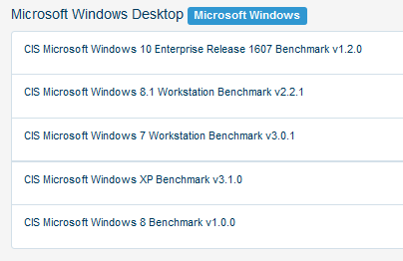
A Look At CIS Security Benchmarks (1)

Slide 7
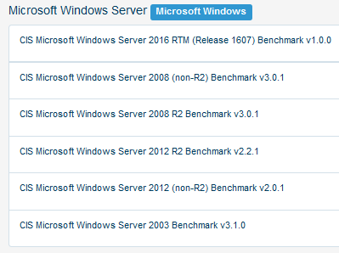
A Look At CIS Security Benchmarks (1)

Slide 8
A Look At CIS Security Benchmarks (1)
# | SERVER SOFTWARE | TOTAL
1 | MICROSOFT IIS (WEB SERVER) | 3
2 | VMWARE (VIRTUALIZATION) | 2
3 | MONGODB (DATABASE SERVER) | 3
4 | IBM DB2 (DATABASE SERVER) | 3
5 | BIND (DNS SERVER) | 1
6 | APACHE TOMCAT (WEB SERVER) | 2
7 | MICROSOFT SQL SERVER (DB SERVER) | 3

Slide 9
A Look At CIS Security Benchmarks (1)
# | SERVER SOFTWARE (CONTD)… | TOTAL
8 | APACHE (HTTP SERVER) | 2
9 | DOCKER (VIRTUALIZATION) | 5
10 | ORACLE (DATABASE SERVER) | 3
11 | KUBERNETES (VIRTUALIZATION) | 1
12 | MIT KERBEROS (AUTHENTICATION) | 1
13 | ORACLE MySQL (DB SERVER) | 4
 | TOTAL BENCH MARKS SERVER SOFTWARE | 33

Slide 10
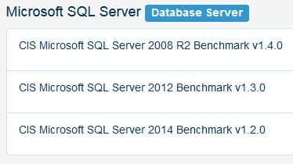
A Look At CIS Security Benchmarks (1)

Slide 11
A Look At CIS Security Benchmarks (1)
# | CLOUD PROVIDERS | TOTAL
1 | AMAZON WEB SERVICES | 2
 | TOTAL CLOUD PROVIDERS | 2

Slide 12
A Look At CIS Security Benchmarks (1)
Next module…remaining categories
END

